Slide 1


Mastering the Application Process
on USAJobs.gov
by
ASC Career Services
Notes:
For applying to nearly all federal government jobs. Some agencies such as CIA use strictly their own website for applications. In particular, the CIA does not even advertise on usajobs.gov, however, they are unique in this point. ALL OTHER FEDERAL AGENCIES ARE REQUIRED TO POST THEIR POSITIONS ON USAJOBS.GOV. Sometimes a posting is simply an advertisement, meaning you will use a different website for the application. This will be indicated in the How to Apply section for the individual posting. Other times, most times, the posting can be applied to through the usajobs.gov system.

Slide 2
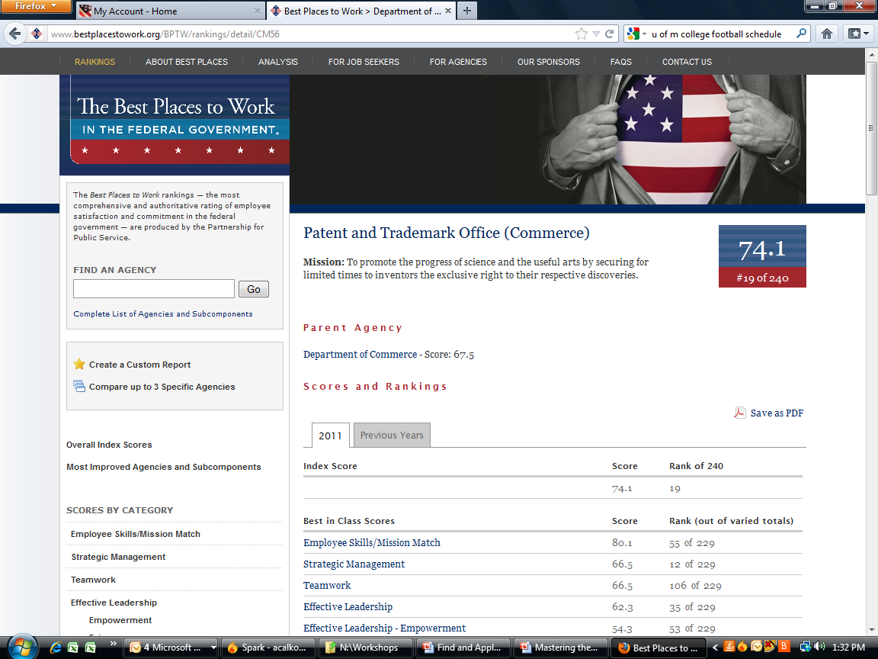
Finding Your Fit: Best Places to Work
Provides overall rankings for agencies and subcomponents
Also ranks agencies based on Best in Class scores in area including Teamwork, Effective Leadership, Support for Diversity and Pay and Benefits
Notes:
Every year, the Office of Personnel Management (OPM) which is Human Resources for the entire federal government, surveys all federal employees and publishes the results on this website. Every agency is ranked according to factors such as teamwork, effective leadership, work life balance, support for diversity, etc. Check it out! Bestplacestowork.org

Slide 3
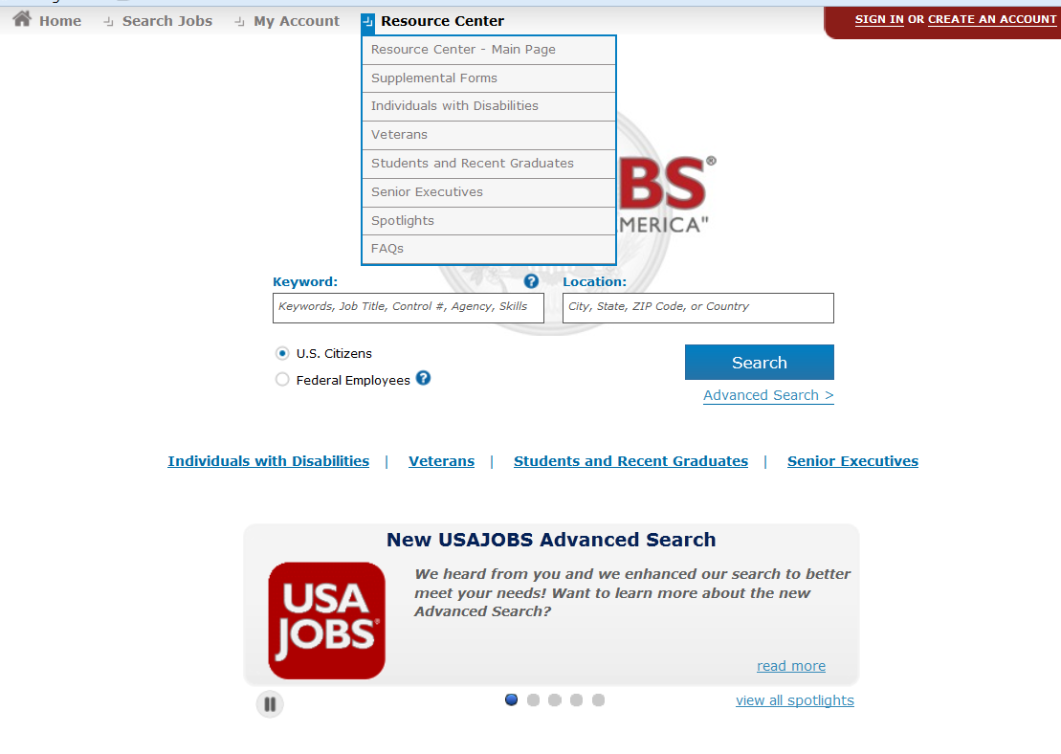
Additional Resources on USAJobs.gov
Notes:
If you have questions about special information for veterans, individuals with disabilities, student programs, supplemental forms, or just general questions about USAjobs or employment with the federal government, use the Resource Center on usajobs.gov

Slide 4
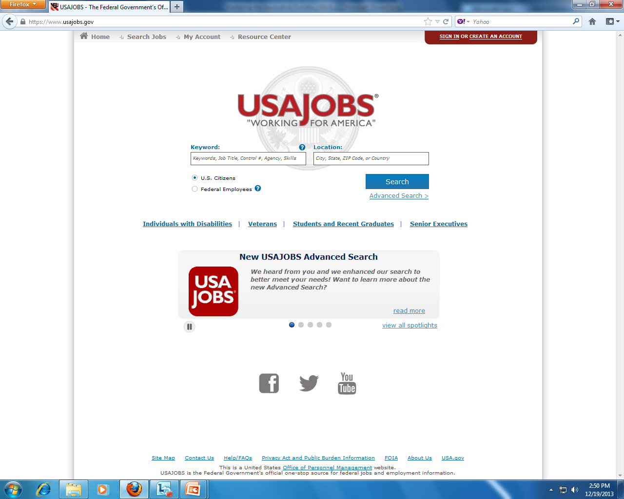
START with
Notes:
The homepage is www.usajobs.gov and you can start here with a simple search. Just indicate a keyword, job title, control # for a posting, the agency, OR the skills needed, OR the city, state, zip code, or country and hit SEARCH.

Slide 5

START with
Notes:
Special information is provided at each of the sections in a red circle above. For veterans, info on veterans preference points; for individuals with disabilities, info on hiring schedules; for students and recent grads, info on the Pathways Program which provides easier access to internships and entry level jobs for students and recent graduates.
Recent graduates: The Pathways Program provides the Recent Graduate Program. You can apply to a Recent Graduate Program position within 2 years of graduating with an associates, bachelor’s, master’s, or PhD program. These positions are temporary, usually 1 year, but they are paid full-time with benefits and provide an excellent pathway into a permanent federal job. The position itself could become permanent, but more likely, by the end of your one year, you will have begun applying for other positions that are open only to federal employees, and you will have established an excellent network of supporters.
Internships: Pathways Internships are always paid and can be completed while you are a student. Look for Pathways Internships! Unpaid internships are called Volunteer Internships or Volunteer positions.
Presidential Management Fellowship: or PMF: open only to those graduating with an advanced degree. A very prestigious program providing rotation through management level positions at one or more agencies during the 2 year appointment. Go to pmf.gov for more details.

Slide 6
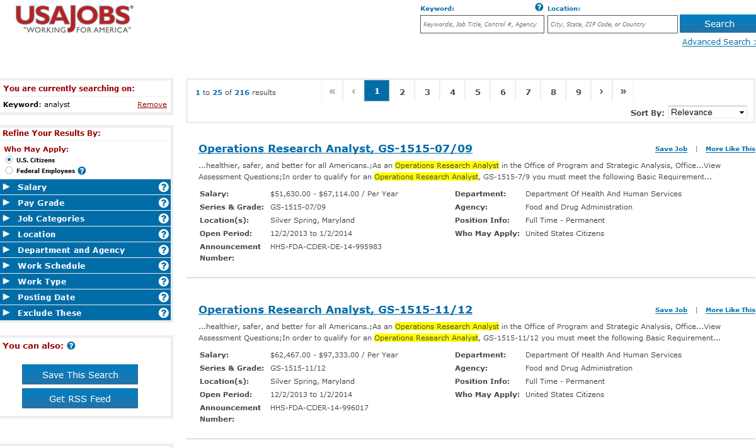
Refine to…
Notes:
If you enter a keyword search, you are likely to get a lot of results. You can refine your results further by clicking on any of the arrows in the blue menu on the left side of the screen. The most effective ones are Pay Grade and Location. If you know you only want to be in one area of the country, location is important.
Pay Grade: GS stands for General Schedule, which is the pay scale system of the federal government. Most agencies use the GS, however some use different lettering systems. You can read the qualifications section of a posting to further understand if you are qualified or not, OR you can Google GS vs IA or whatever the lettering system is to determine how they match up. If you are graduating with a BA or BS, then you will automatically qualify for the GS-5. You MAY qualify for a GS-7, but only as indicated in the Qualifications section. This will be explained more fully later in this presentation.

Slide 7
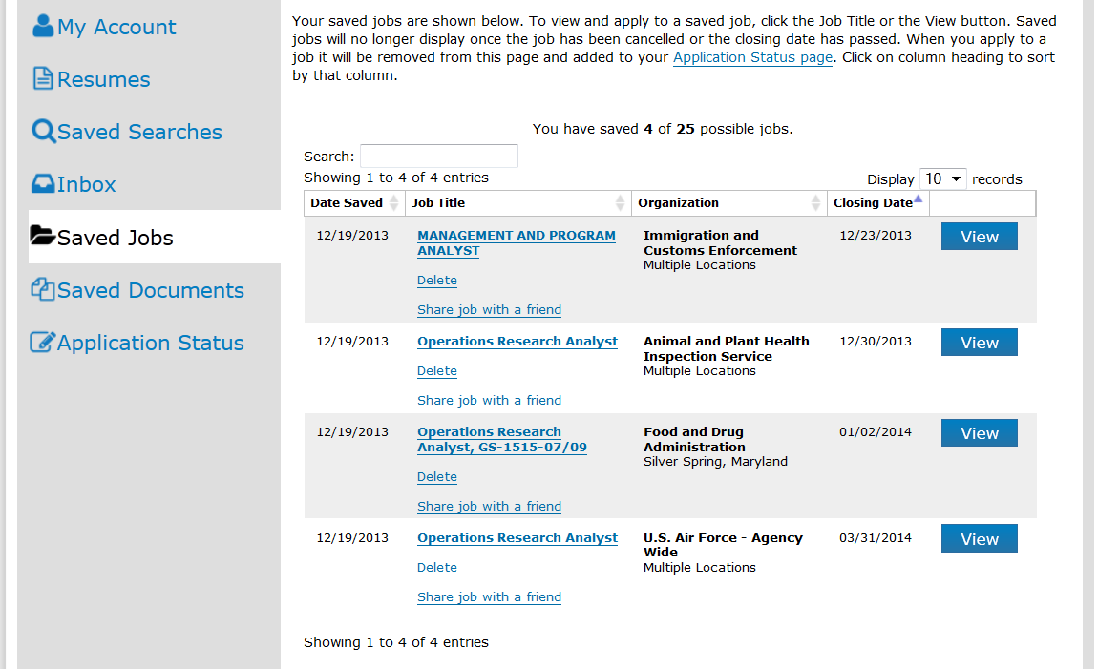
Saved Jobs
Notes:
When you run a search, you can choose to the save the job. Then you can go to your account homepage and click on Saved Jobs. The system will email you when one of your saved jobs is about to close.

Slide 8
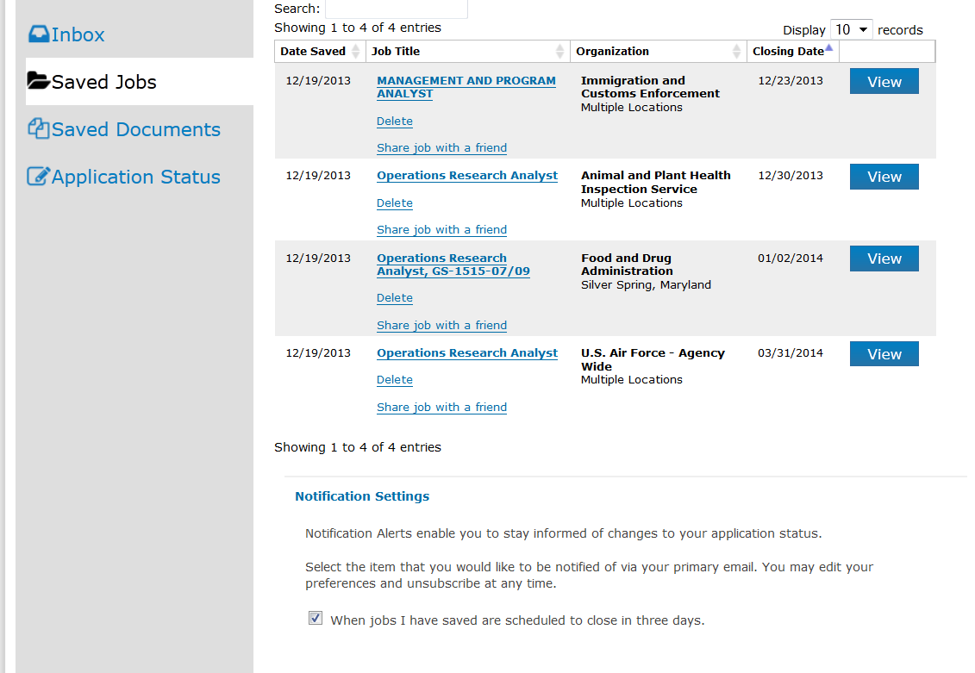
Saved Jobs

Slide 9
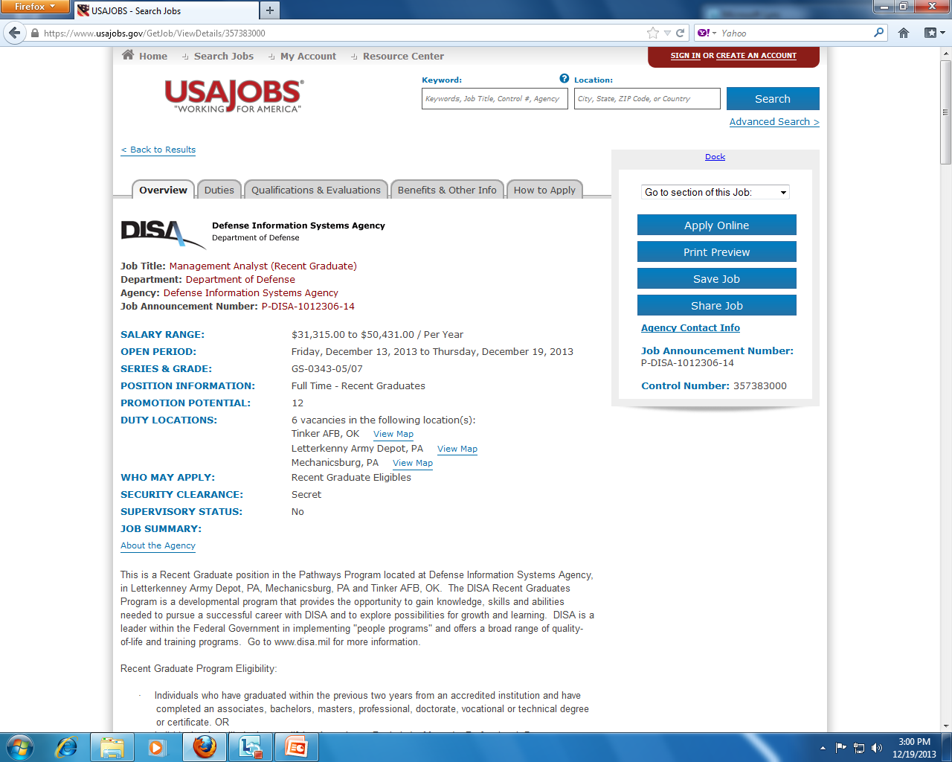
Anatomy of a vacancy announcement
Notes:
When you click on the job, you get the actual vacancy announcement.
It’s helpful to understand the anatomy of a vacancy announcement which has 5 parts.
The 5 parts or tabs are:
Overview
Duties
Qualifications and Evaluation
Benefits and Other Information
How to Apply
This makes it easy to navigate around the job announcement.
Because these jobs are very competitive, careful reading of the announcement is strongly urged.

Slide 10
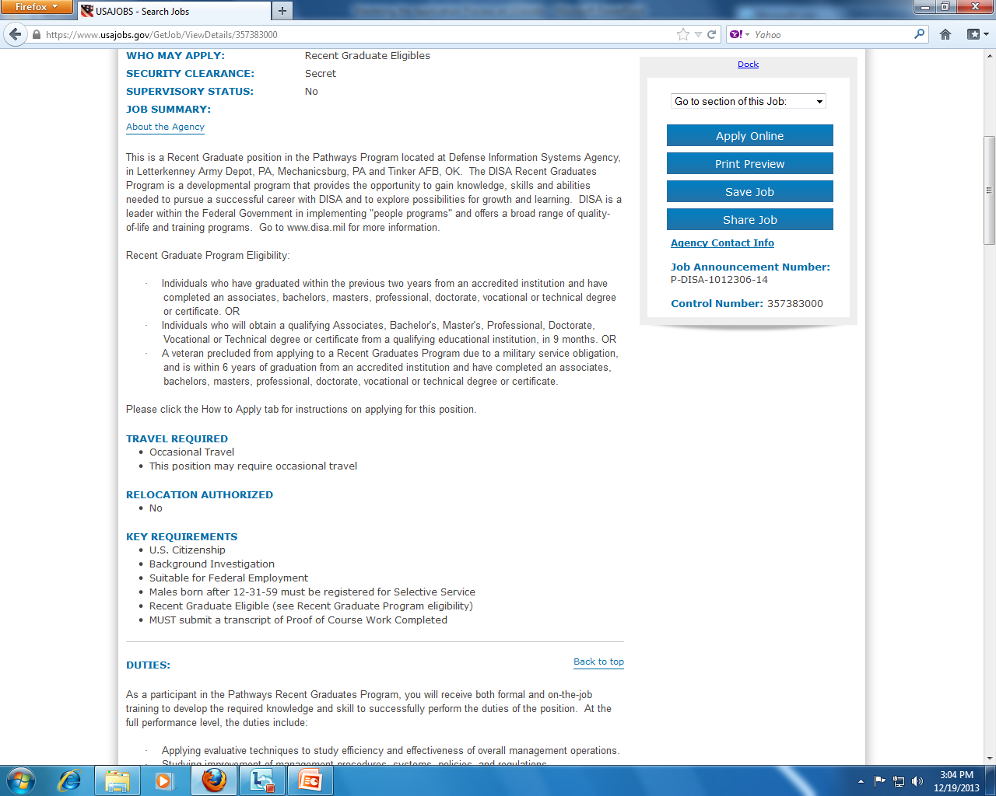
Anatomy of a vacancy announcement
Notes:
Job Summary provides an overview of the agency and of the position. It usually provides some key requirements – if you don’t meet these key requirements, don’t bother reading further into the announcement!!
This example is for a Recent Graduate position.

Slide 11
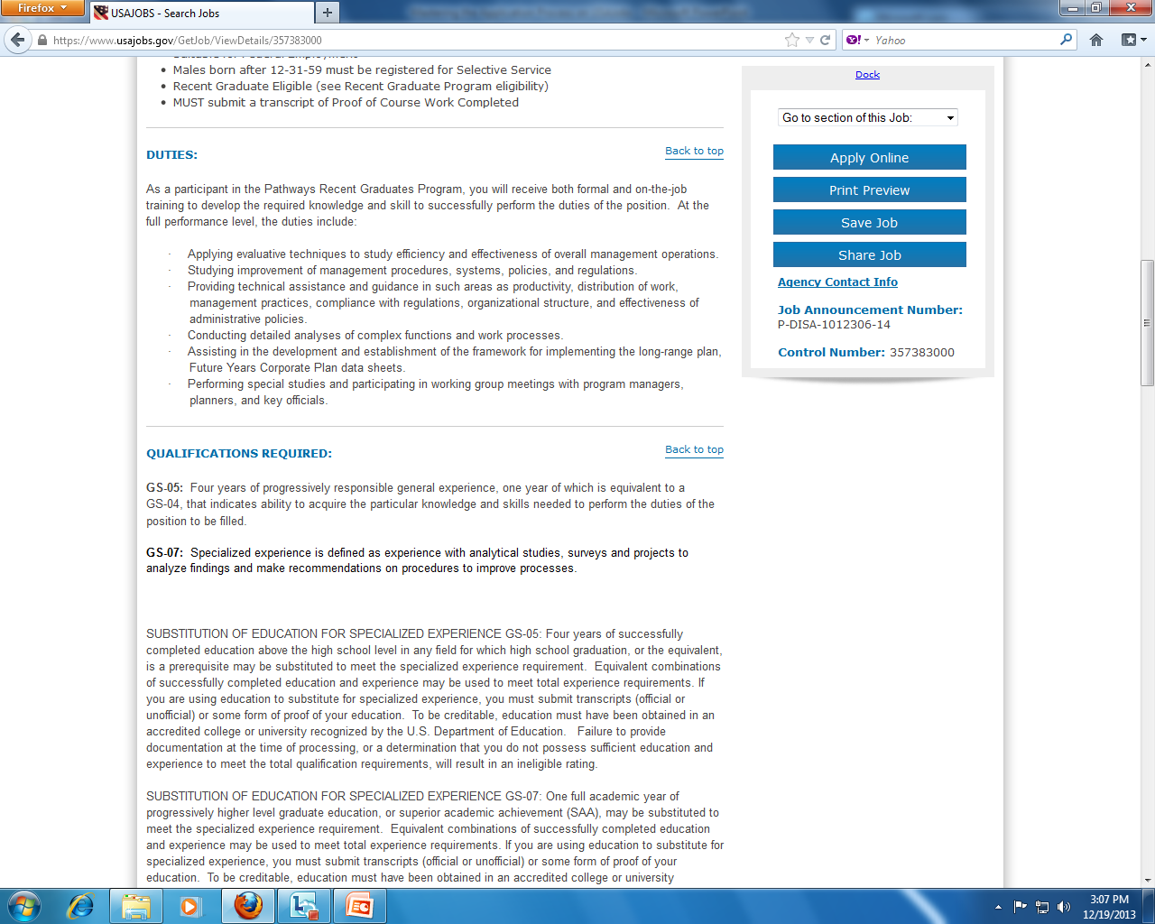
Anatomy of a vacancy announcement
DUTIES
Lists major duties and responsibilities of the position, adding more detail to the brief overview
Notes:
Next is the information on Duties. This is an opportunity to look carefully at the duties of the job to see if this is work that sounds interesting to you – to see if it is something that sounds like a good fit for your education and training; a good fit for your level and previous work experience. Agencies usually spend a lot of time on this section and the qualifications section. You do not need to know how to do every single thing in the Duties section, but if it sounds like a foreign language to you or you can’t figure out what they mean by a certain phrase, do not apply. If it makes sense and you have some relevant or transferable experience and skills, read further to make sure you are qualified before you apply.
*Note: Use the Duties section to inform your writing of solid descriptions of work experience, knowledge, skills, and accomplishments! Use the same wording as needed!

Slide 12
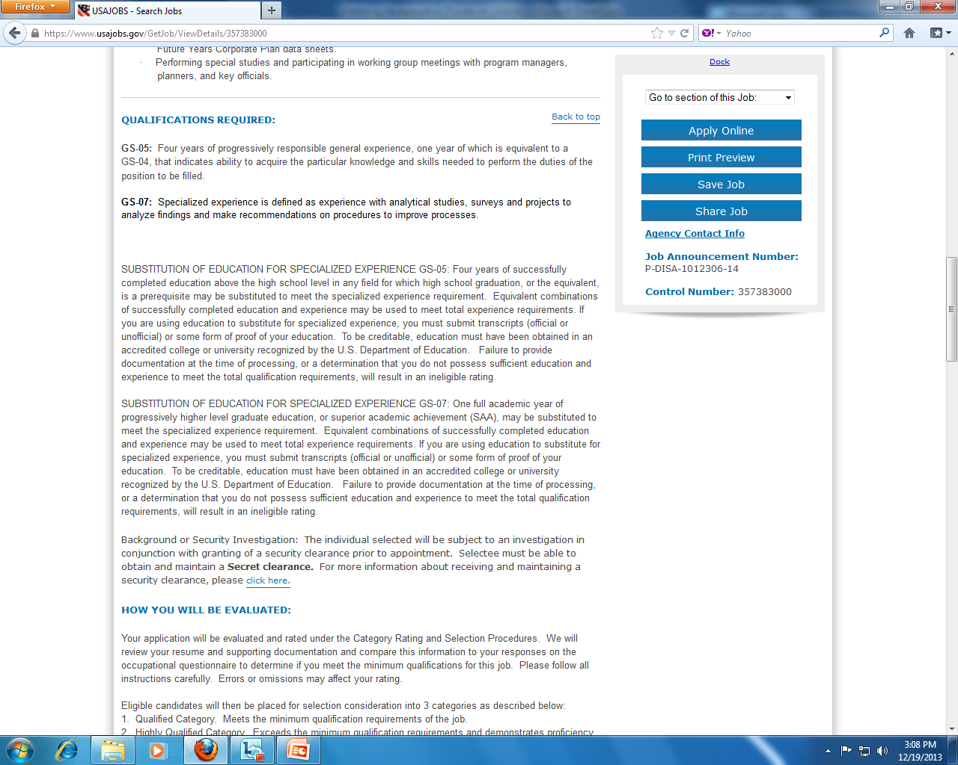
Anatomy of a vacancy announcement
QUALIFICATIONS & EVALUATION
Identifies skills and experience needed for the role and explains how applications will be assessed
Notes:
Then look at the qualifications because these will give you important insight into precisely what background, training, and experience the agency is looking for in the person they hope to hire for the position. The qualifications also provide important clues as to how your experience will be evaluated and how you will be reviewed if you choose to apply.
**NOTE: Be certain for watch for the phrase “All requirements/qualifications must be met by the closing date of this position” If this phrase is present and the position requires a degree, then you must have the degree IN HAND before the deadline of the position. So, if you are graduating at the end of the semester but the closing date is before the end of the semester, you CANNOT apply for the position. This is not a rare requirement, so please do make sure you read this section carefully.

Slide 13

Anatomy of a vacancy announcement
Notes:
If you want to apply to the position at the GS-7 level (which is a higher salary than the GS-5), you MUST check to see if a section like that highlighted in the slide exists. IF, in the Substitution of Education for Specialized Experience section, it indicates that you MAY use education to substitute for experience at the GS-7 AND it states that you may have Superior Academic Achievement – meaning a 3.0 or higher – then you may qualify for the position. Other ways to indicate Superior Academic Achievement are through national honor society membership or high class ranking. You only need one of those qualifications or the 3.0 cumulative GPA in order to qualify for Superior Academic Achievement.
WARNING: a posting MUST indicate that you can substitute education for experience in order for you to do so.

Slide 14
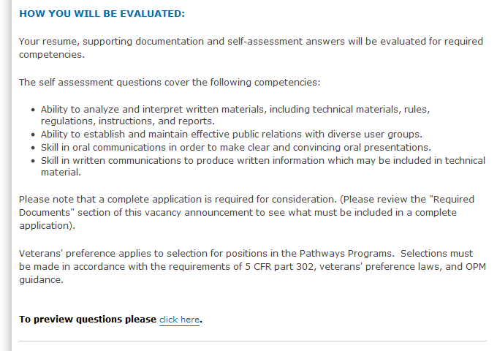
Anatomy of a vacancy announcement
EVALUATIONS
KSA s – Knowledge, Skills, and Abilities you must illustrate in your application in order to be considered.
Be sure to preview the questions
Notes:
Sometimes the How You Will be Evaluated section is extremely helpful, like the one shown on the slide. This one provides a specific list of skills that you need to be sure to indicate on your resume in order to be considered for the position. Make sure you explicitly mention these skills! It’s not considered plagiarism to use the same wording. Most of the time though, this section contains some boiler plate text that talks about best qualified, qualified or not qualified categories used to separate candidates.
Something to watch out for – “to preview questions please click here:” whenever you see this, CLICK IT and READ THE QUESTIONS. If you read through the questions and can’t answer them, DO NOT APPLY. If you can with a reasonable level of confidence, then proceed!

Slide 15
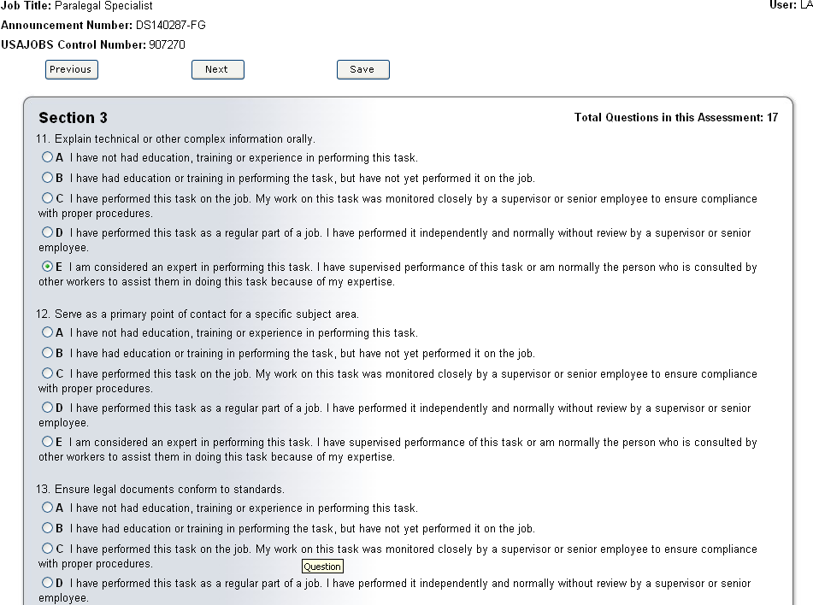
Sample questionnaire
Serve as a primary point of contact for a specific subject matter.
I have not had education, training or experience in performing this task.
I have had education or training in performing the task, but have not yet performed it on the job.
I have performed this task on the job. My work on this task was monitored closely by a supervisor or senior employee to ensure compliance with proper procedures.
I have performed this task as a regular part of my job. I have performed it independently and normally without review by a supervisor or senior employee.
I am considered an expert in performing this task. I have supervised performance of this task or am normally the person who is consulted by other workers to assist them in this task because of my expertise.
Notes:
Many entry level positions ask you to complete a questionnaire that ask for you to answer a multiple choice question with some boxes to explain your answer. Let’s bring out an example question.
You will want to read through each answer and select that one that fits your level of experience. Be honest, and don’t worry if you select the lowest answer for some of the questions. However, do make sure that you are giving yourself credit for EVERYTHING you’ve done, even if you only did it once. For option B, be sure to remember if you’ve ever taken a class on the subject or completed a class project relevant to the subject – these are completely valid!!
These are not short questionnaires, some are over 100 questions, so you are not expected to be at the expert level on each question. Plus, you do not want to go to an interview and not be able to prove that you are as skilled as you said you were.

Slide 16
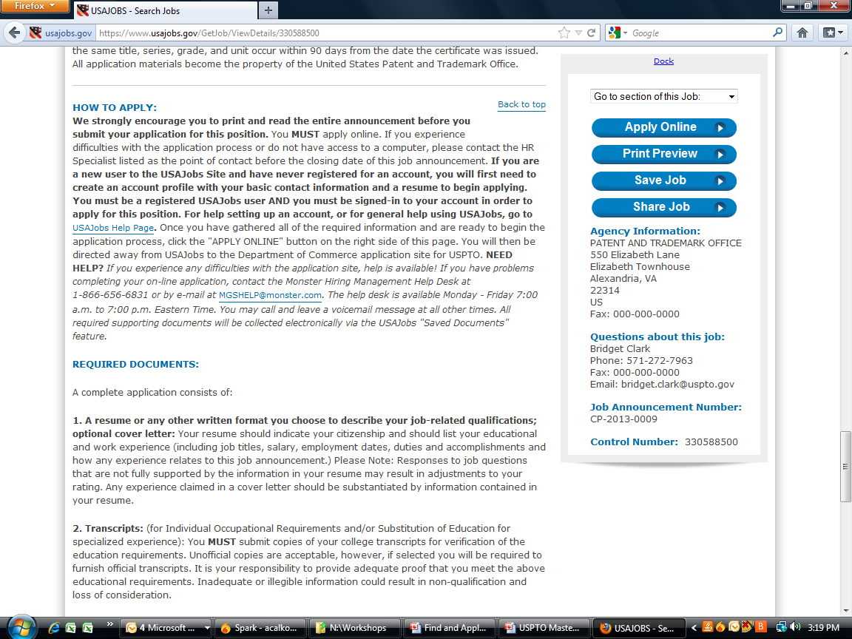
Anatomy of a vacancy announcement
HOW TO APPLY
Provides step-by-step instructions on how to apply
Notes:
Finally the last tab presents information on how to apply and the due date.
Generally agencies require that applications be submitted electronically online, but there are some exceptions when applications may still be submitted on paper. Although it seems obvious, it is important to keep one’s eye on the due date for the application; from time to time, applicants miss the due date. But agencies almost never make exceptions for late applications: late is late.
If an agency wants you to use an outside site, it will be indicated here. Sometimes, those outside sources pull your info from USAJobs.gov to make it easier to apply.

Slide 17
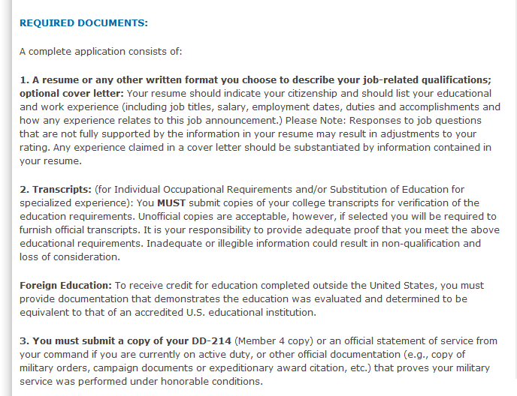
Anatomy of a vacancy announcement
HOW TO APPLY: REQUIRED DOCUMENTS
Provides a breakdown of what exact documents are needed
Use your Advising Report from My Student Center in BuckeyeLink
Notes:
Be sure to double check that you have all of the documents indicated in the Required Documents section. During the initial application, nearly all agencies accept an Advising Report as an unofficial transcript. You will be required to send an official transcript if you are selected for an interview or before you accept a job offer. If you are unsure if an Advising Report is acceptable, call the agency at the contact number indicated in the Agency Contact Info section.

Slide 18
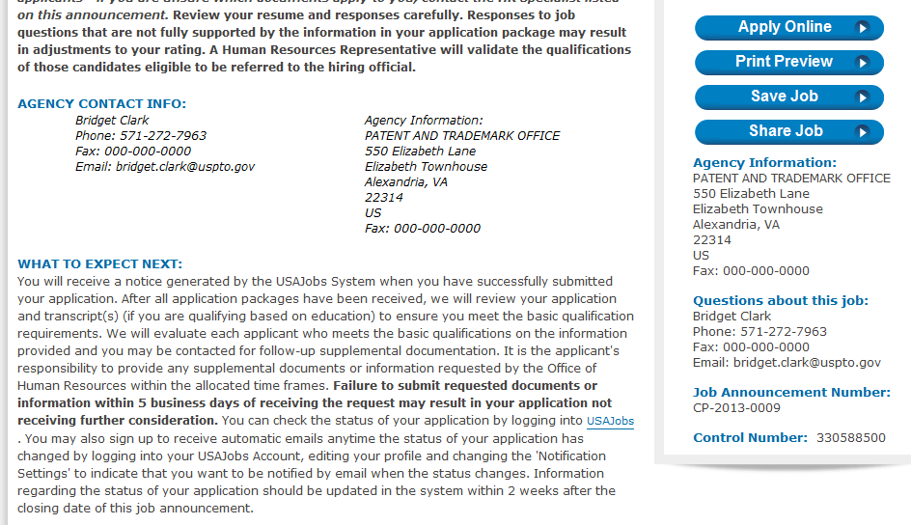
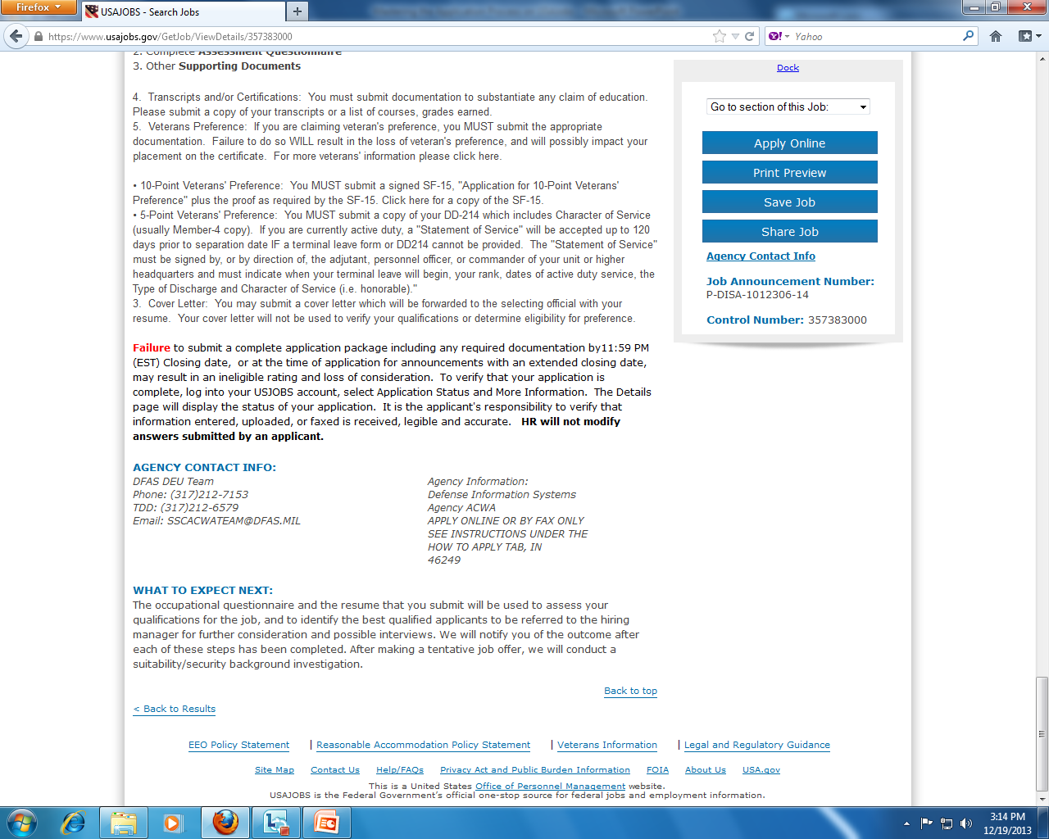
Anatomy of a vacancy announcement
IMPORTANT! Save this info. Use it for the cover letter and to follow up after the posting closes.
Provides information on when/how applicants can expect to hear from the agency
Notes:
It is really important to save the contact info and control number for the position you are applying to. Once the posting closes, all of this information disappears. The best practice is to print or copy/paste the ENTIRE job posting into a Word document and save it to your PC/MAC or a flash drive. Further, make yourself a spreadsheet that contains the pertinent info like: control #, position title, agency, division, pay grade, closing date, date you applied, and agency contact info. It might be SEVERAL MONTHS before you are contacted for an interview. Keeping track of this information will help you remember the position you applied for and prepare for the interview months later.
The What to Expect Next section is not reliable. Do not expect to see the results indicated.

Slide 19
Building a federal resume online
Create a user name and password
Complete the profile portion, including work locations desired
Under RESUMES, choose BUILD NEW RESUME
Name the resume and begin!

Slide 20
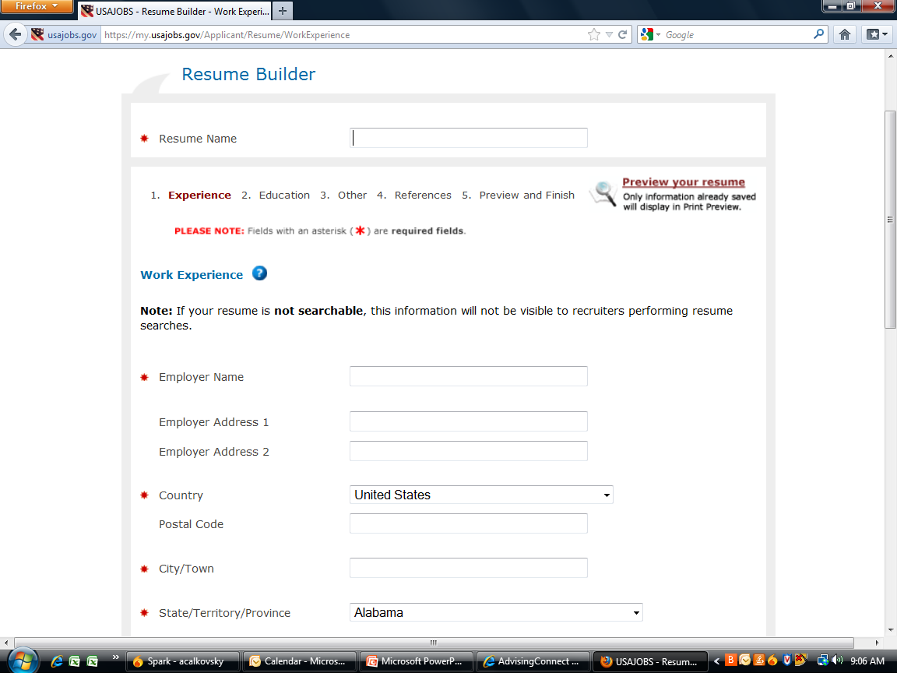
Work Experience
In this section, include full-time, part-time, internships, co-ops, and heavy duty volunteer experience

Slide 21
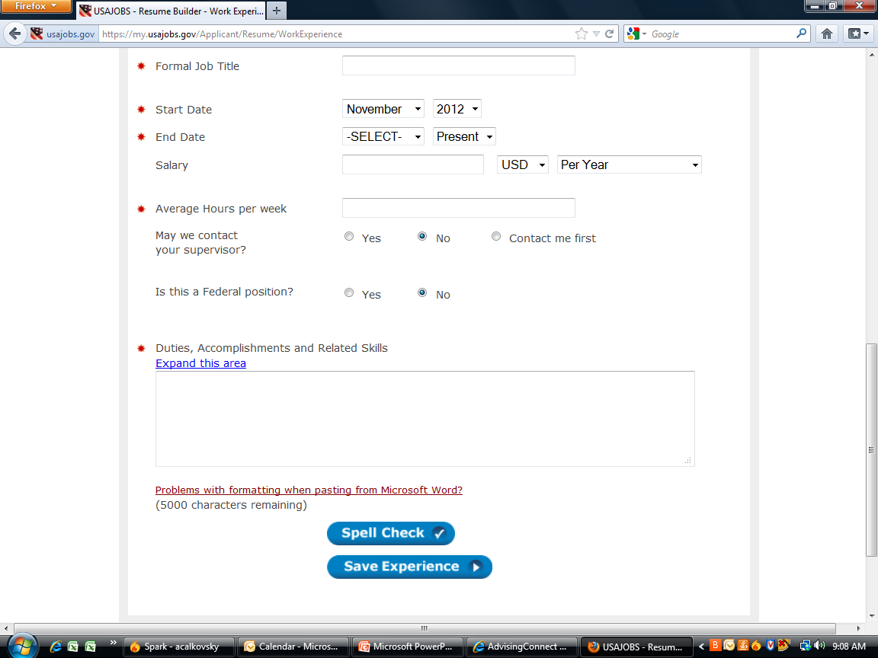
Work Experience
Create sentences using action verb + task + importance format to create impact. Describe accomplishments, not just a ticker list of tasks. Use #, %, statistics, $$, etc to create impact. Make the most of this area. Use buzzwords/keywords from position description.
Notes:
The importance of using keywords and buzzwords from the Duties, Qualifications, and How You Will Be Evaluated sections cannot be overstated. For most federal positions, the agency or the Office of Personnel Management will use a computerized scanning program to search applications for keywords. If you do not match enough keywords, your application will not be forwarded to the hiring manager for the particular agency.
Detail, detail, detail. Use an excessive amount of detail to describe ALL of your accomplishments, skills, and knowledge. Use the entire 5000 characters! Also, it is not important to use physical bullet points in the Resume Builder. You may choose to do so, and you can copy/paste it from Word, but it isn’t necessary at all. After all, bullet points count as characters. Running your sentences or fragments together as a paragraph, using periods or semi-colons to separate thoughts/ideas is perfectly acceptable. However, do NOT use I or other personal pronouns. This is not a personal narrative, but rather an OBJECTIVE description of your knowledge, skills, abilities, and accomplishments.

Slide 22
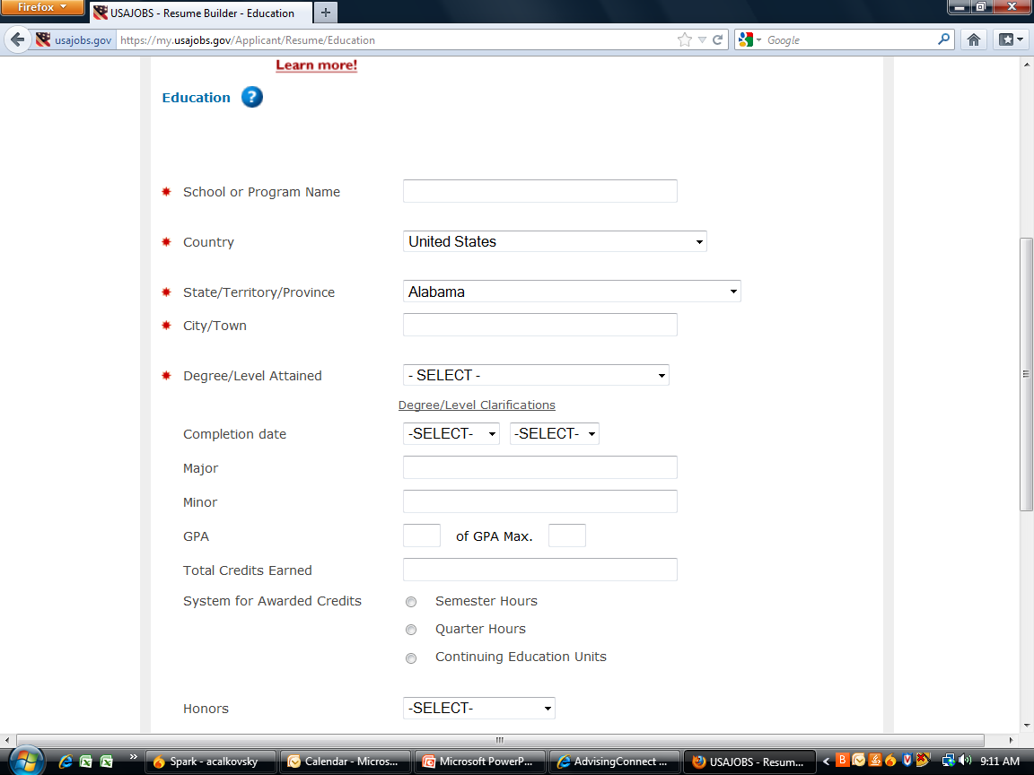
Education
Include all schools attended, even if you didn’t earn a degree. If it shows up on a transcript, include it. Also a good idea to include high school if you are under 30 or if your high school is in the same region as the agency, or if you have relevant experiences to incorporate.

Slide 23
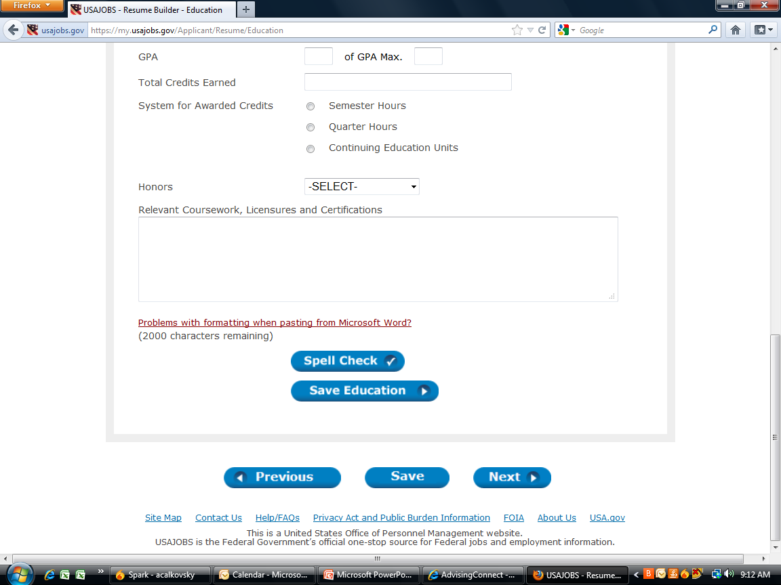
Education – Relevant Coursework/Projects
Make good use of these 2000 characters! Describe course projects, research papers, group projects, presentations, etc that are relevant to the skills & knowledge needed for the position.
Notes:
Read the Duties, Qualifications, and the How You Will Be Evaluated sections of the posting to decide which projects and presentations you want to include. Even simply describing the purpose of a course is enough – you don’t necessarily have to describe a project or a paper. The foundational education is what is important.

Slide 24
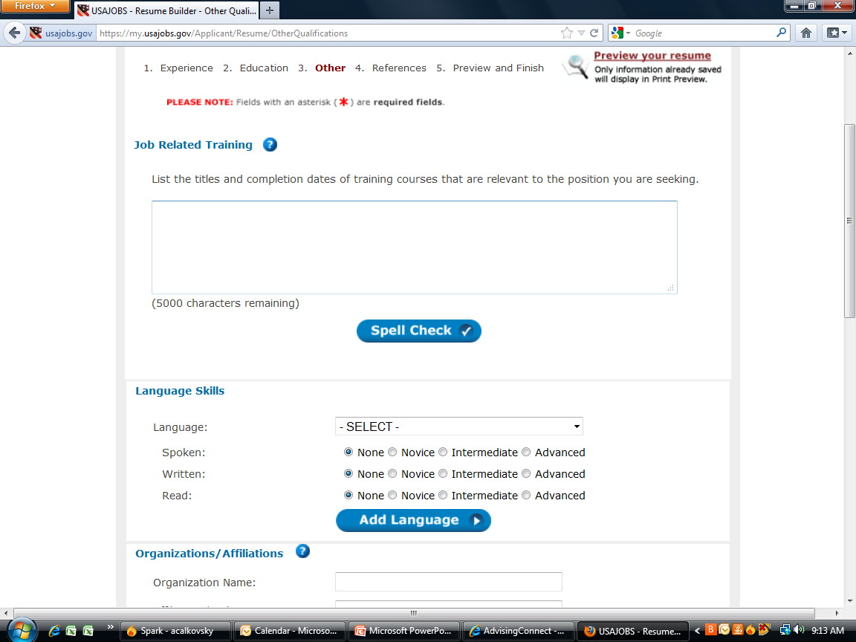
Other Info – Training, Language Skills
Many students and recent grads will not have anything in this section. However, if you have had specific training through an internship or co-op experience, or through the military, definitely include it!
Language skill is always valuable. Be sure to assess your ability accurately.
Notes:
When it comes to Language Skills, be very clear about your skill level. Graduating from college with two semesters of a foreign language means you are probably a NOVICE, NOT Advanced. If you majored in a foreign language or are a native speaker, then Advanced is appropriate. Intermediate would apply if you have a minor in the language or if you are able to communicate with a native in a conversation but not able to read academic texts nor business operations manuals.

Slide 25
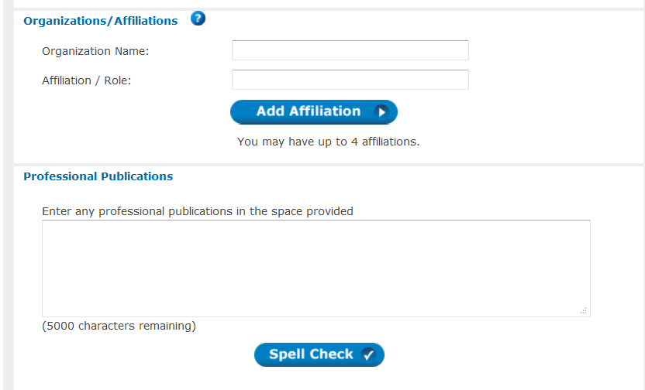
Other Info: Affiliations and Publications
Affiliations could include trade associations, clubs, nonprofit organizations, honor societies, or industry specific organizations you are a member of.
Not a field most undergrads can fill but if you have been published, Kudos! Provide the title and a synopsis of the piece.
Notes:
For Organizations/Affiliations, do not include political parties, religious organizations, or extremist groups – those are all personal choices and should be kept out of the professional realm. Indeed, some of those could provide a reason to disqualify you from the position.

Slide 26
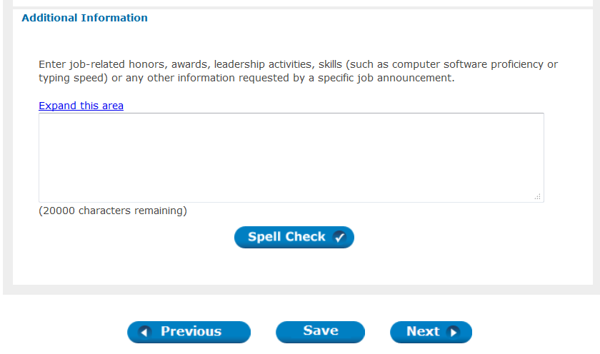
Additional Information: I.E: Everything Else!
20,000 characters – what else do you have to say? In this space, mention honors, awards, volunteer work, computer skills – ALL OF THEM, office equipment usage, typing speed, etc. Don’t know your typing speed? Google “free typing test” and find out!
Notes:
Other items to consider for this section: leadership activities, computer software (include your level of skill), computer hardware, Mac vs PC or both, additional course descriptions or papers/projects/presentations that didn’t fit in the Education section. Interests and Activities that are RELEVANT are also important to include. For instance, if you are interested in jobs as an analyst or an economist, include your regular reading of publications such as the Economist, NY Times, Washington Post, Wall Street Journal, peer reviewed journals for a particular subject area, etc. If you are applying to positions with the EPA or the Dept. of Natural Resources, they would want to know if you are something of an environmentalist or conservationist in your personal life. They would want to know if you are an outdoorsman, a Girl or Boy Scout, an Eagle Scout, or part of any other similar group where you developed an appreciation for nature and gained skills in specific tasks. If you know how to operate equipment like fork lifts, ATVs, tractors, boats with onboard motors or sails, or other such specialized equipment, add these things to this section WHEN RELEVANT.

Slide 27
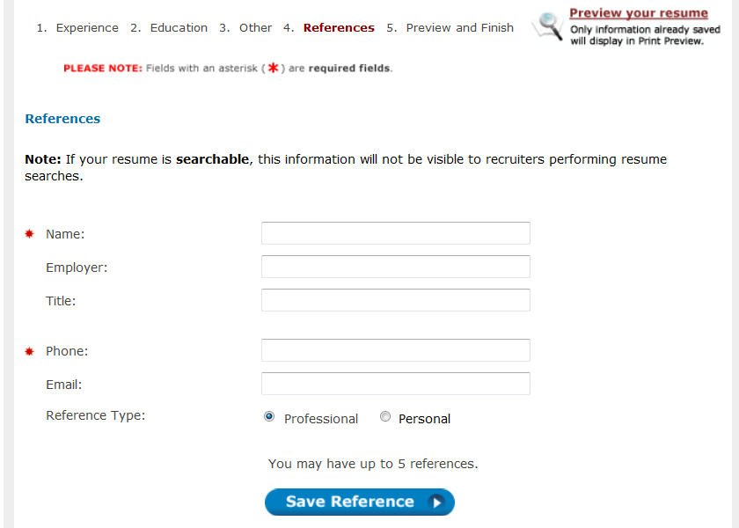
References: Professional & Personal

Slide 28
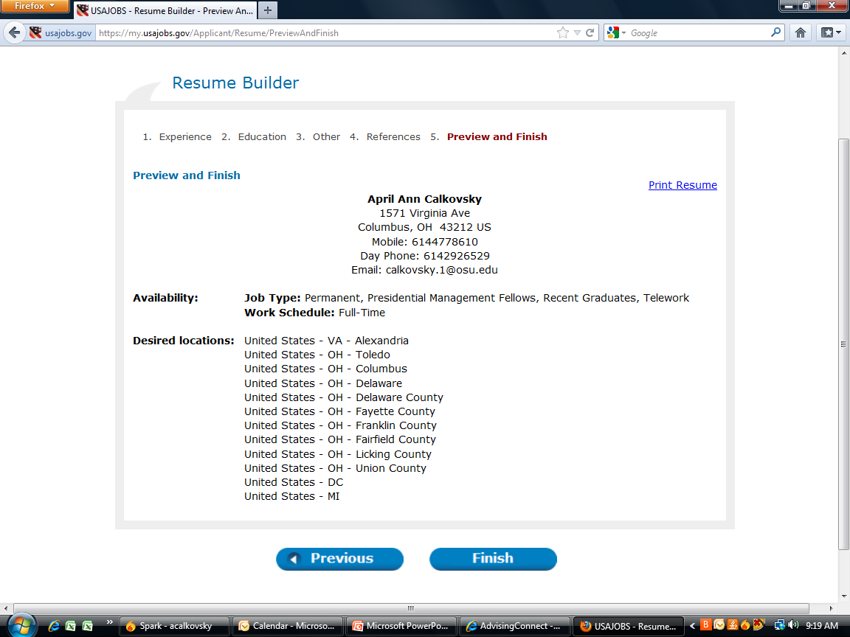
Review & Finish
Your Name
Yikes! The final format is not pretty, but you don’t need to be concerned with that. Just make sure all of your relevant knowledge, skills, abilities, and experiences have been adequately addressed.
Notes:
Do not worry about the final format.

Slide 29
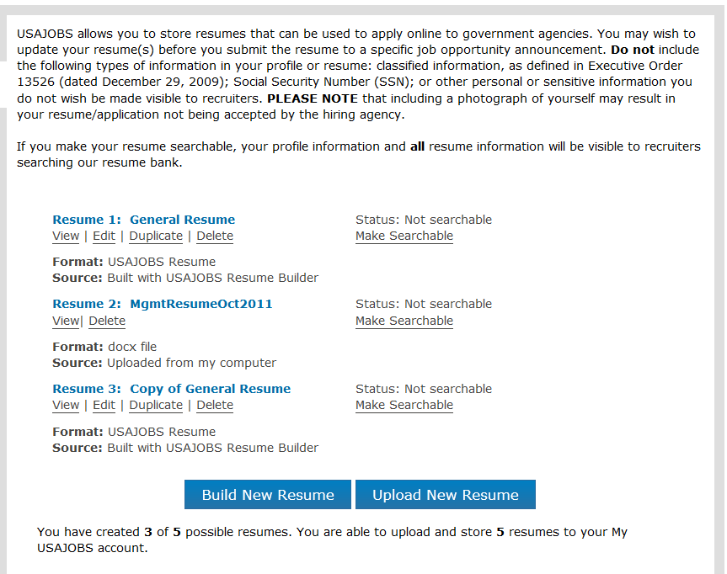
Searchable vs. Not Searchable
You can have up to 5 resumes in the system, allowing for customization per posting. Uploaded resumes count toward this total. Make one, some, or all of them searchable, which means agencies can search for you based on keywords and skills. If you make more than one searchable, then agencies can see all of the searchable resumes. Turn it on or off at will.
Notes:
The value of creating up to 5 different resumes is indicated if you are applying for a wide variety of job functions. The information you choose to include in course/project descriptions and in the additional information section may vary depending upon the job duties. The best practice is to create a General or Master Resume which includes absolutely EVERYTHING that you might ever want to say. Then, when it is time to customize your resume for a specific job, simply click DUPLICATE under that master resume. A new template will appear which you will name for that job function, and ALL of the data from the master resume will be in place. Simply go through each section and add or delete items as needed.
There is not much value to making resumes searchable. Agency HR personnel rarely take the time to search for candidates this way.

Slide 30
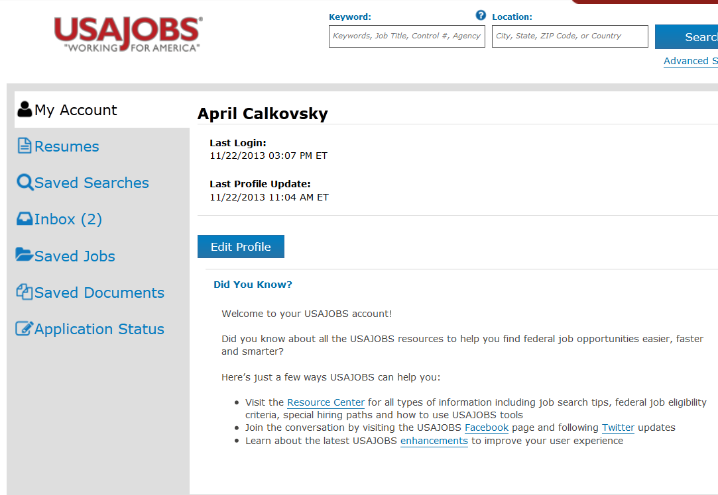
Create a Saved Search
Notes:
In order to save yourself time and energy, create Saved Searches so that you can avoid having to look through the 7000 postings regularly available. You can have up to 10 saved searches, which is great because you can have broad searches like “analyst” and then very specific searches such as “analyst, in Columbus, Ohio, for the Defense Logistics Agency” The system will email you whenever positions open that meet your search criteria. This means you may receive 10 separate emails from the system on a given day, however, it takes just a few seconds to scan the job titles, pay, and closing date to determine if you want to save the position and apply later, or simply delete the email for that day.

Slide 31
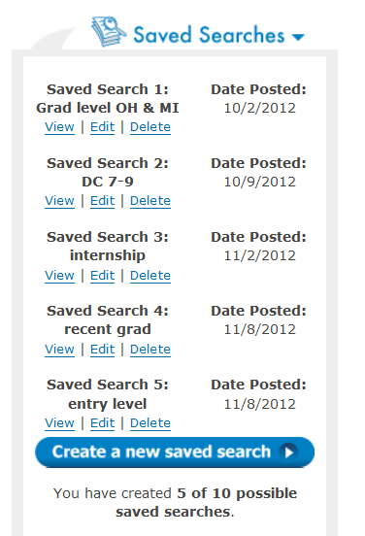
Create a Saved Search
Saved Searches are essential if you want to be notified about new opportunities with any agency.
Sometimes agencies create very short application windows or they have a cap on applications they want to receive and close it without warning. It’s best to apply as soon as you see the announcement open.
Receive these notifications DAILY to take advantage of the opportunities quickly.

Slide 32
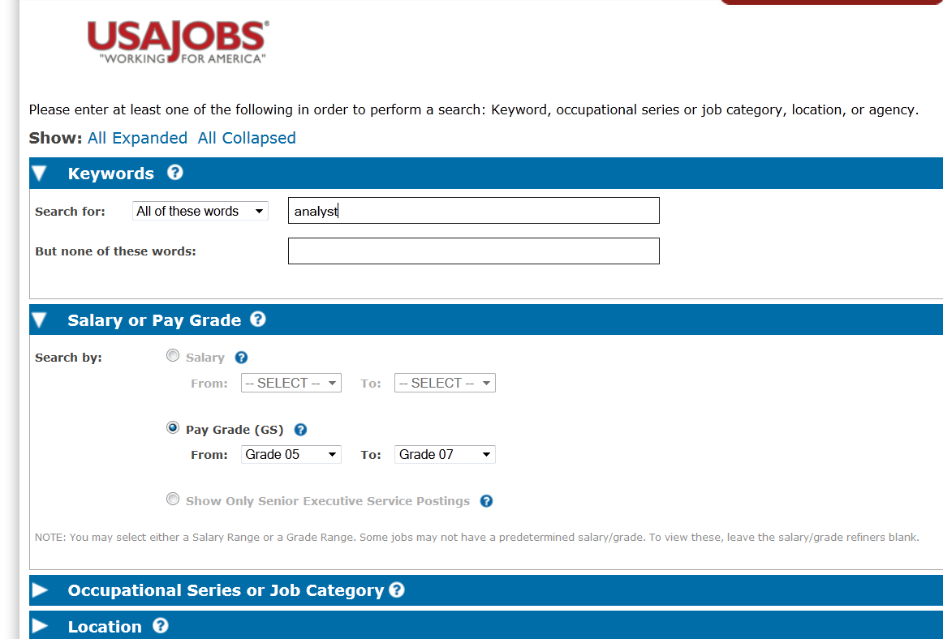
Create a Saved Search: Keyword + Pay Grade
A BS will typically enable you to apply to a GS-5-7 pay grade. An MS a GS-9-11 and a PhD GS-11 and up.
Notes:
When using Keywords, make use of quotation marks when looking for phrase. For instance, if you just say intern, you may have several medical doctor positions in your results because they say the word intern somewhere in the posting. It’s better to search on “Internship Program” or “Pathways Internship.” Similarly for Recent Graduate Program positions, the best results will be found if you type “Recent Graduate Program” in the keyword box WITH the quotation marks.
The easiest way to find positions that you could actually qualify for is by using the Pay Grade criteria. If you have a 3.0 cumulative GPA or higher, then always set it Grade 05 to Grade 07. If you have lower than a 3.0, set it as Grade 01 to Grade 05. If you are only searching for internships, set it as Grade 01 to Grade 07 because some internships are entered as Grade 01-04 since they don’t require a degree.

Slide 33
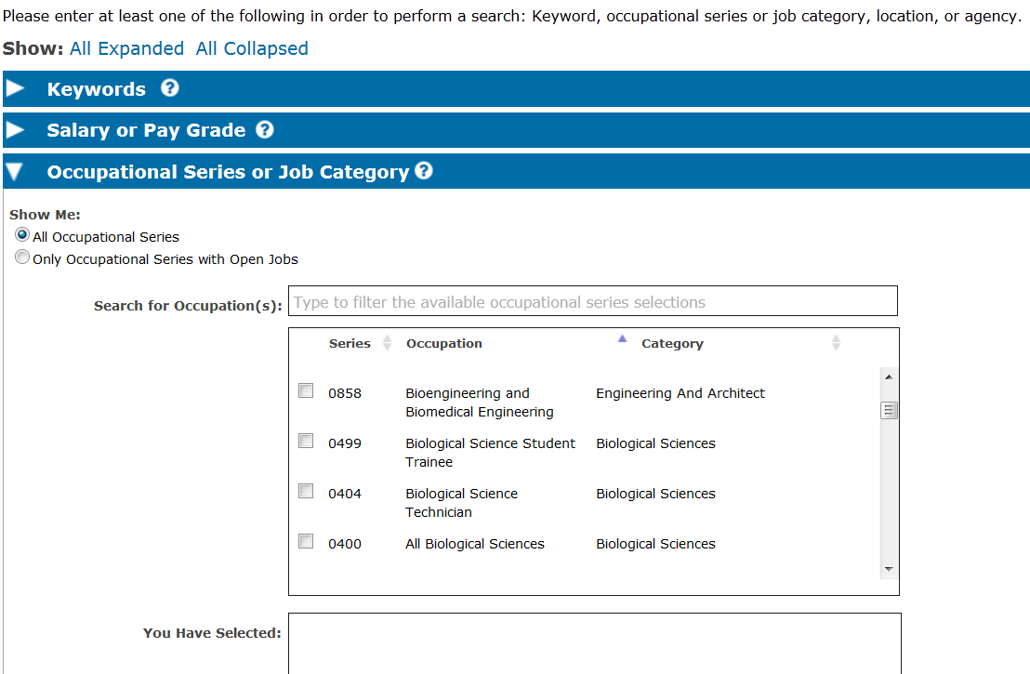
Create a Saved Search: Occupational Series
Notes:
To learn more about the Series and job Category, Google: “OPM Occupational Series”
This is a pretty specific criteria, so make sure you also have other more general searches.

Slide 34
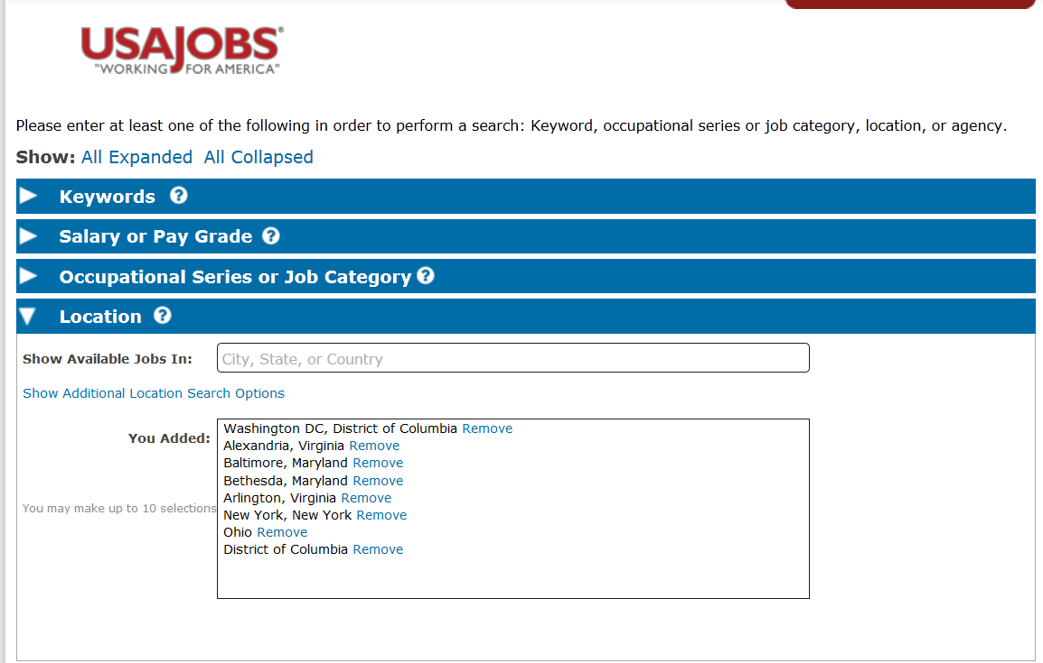
Create a Saved Search: Location
You can also click on one state or country and choose specific cities.
Notes:
You may have up to 10 locations in a single search, so there are lots of ways to slice and dice this criteria. You can choose a whole state, such as Ohio, or you can be specific and say a city and state. As you type a city or a state, the list begins to populate and you can click on the one you want. You can also choose countries other than the United States.

Slide 35
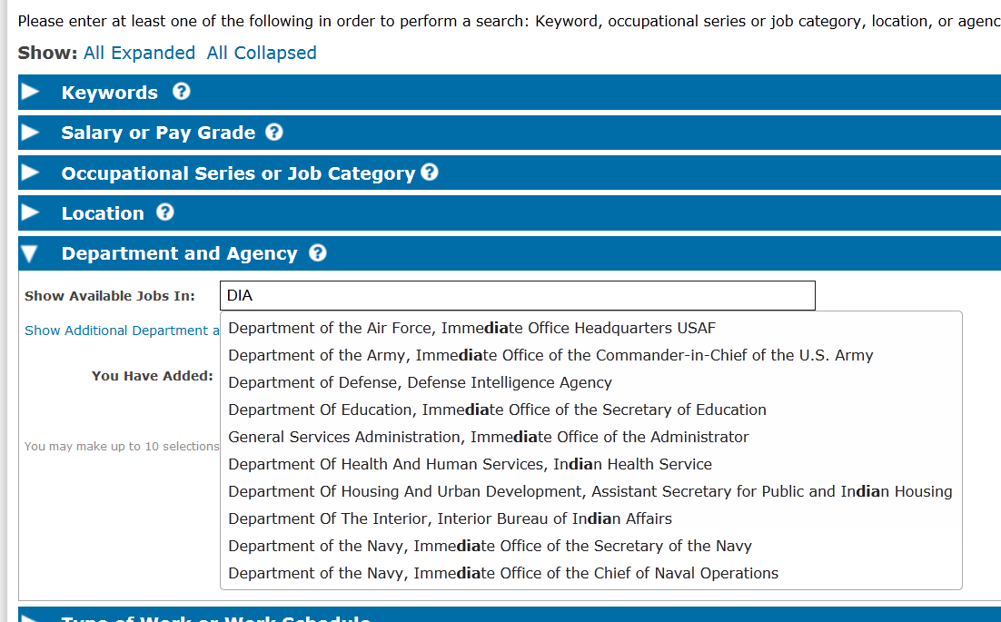
Create a Saved Search: Agency
This is the best way to create a search if you are only interested in ONE agency.
Notes:
If you are only interested in ONE agency such as the CIA, then create a separate search for that one agency and make the agency name the ONLY criteria in addition to pay grade.
When searching for agency names, it is best NOT to search for the initials of the agency. As the slide above shows, searching for DIA brings up a list of any agency with the letters “dia” contiguous to each other.

Slide 36
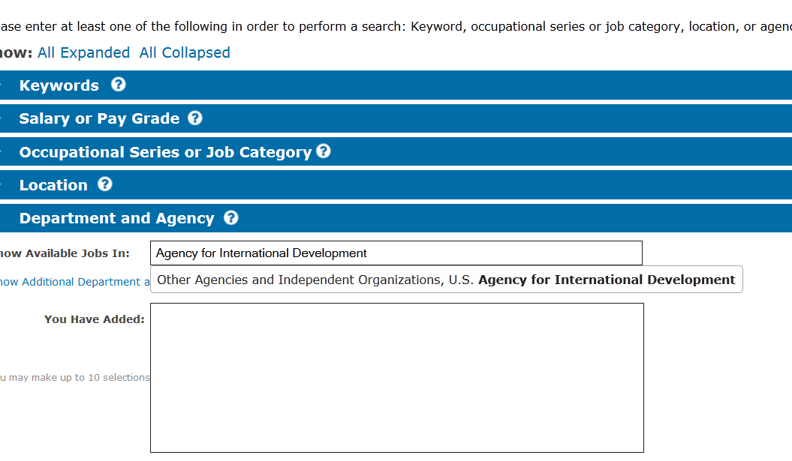
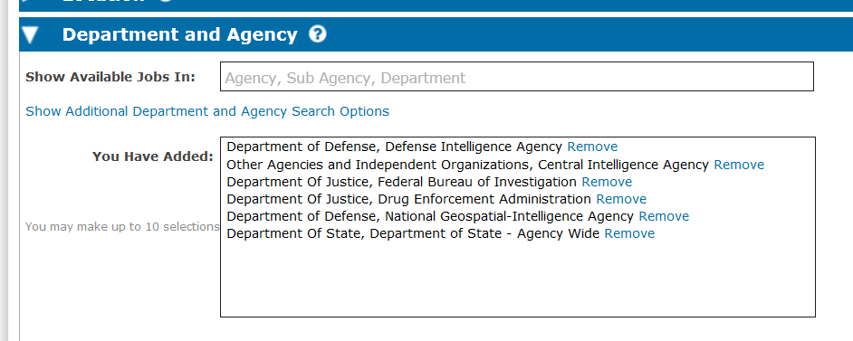
Create a Saved Search: Agency
Notes:
There is a group of agencies categorized as “Other Agencies and Independent Organizations.” This includes the AID, the CIA, and the Post Office, among many others. As mentioned, it is best to spell out the entire agency name in order to find it in the list.
If you are interested in ALL agencies within a Department, such as the Department of Justice, then you can type Department of Justice, choose it from the list, and it will send you positions in any DOJ agency.

Slide 37
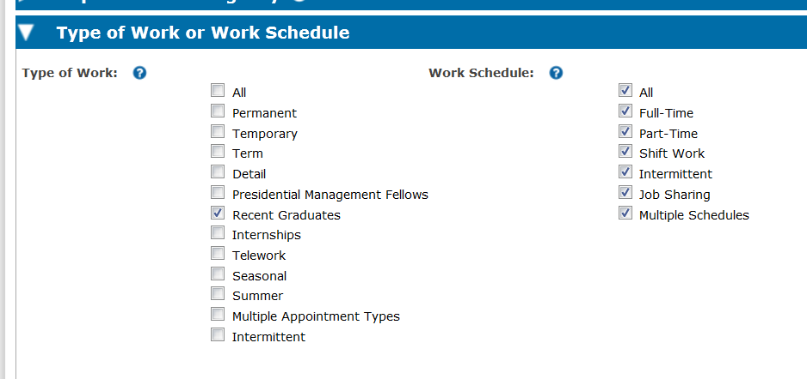
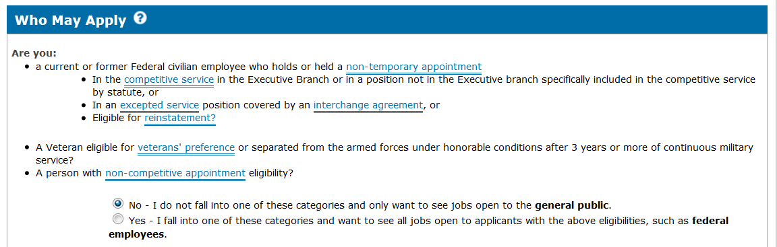
Saved Search: Eligibility & Type of Work
Be careful not to make too many choices here as it will limit your results.
If you are veteran or person with a disability, or if you are a person who has served as an AmericorpsVista or in the PeaceCorps, then you can choose YES and view additional opportunities not available to all U.S. Citizens.
Notes:
In Type of Work or Work Schedule, don’t make too many choices – either leave it blank OR select ALL. However, if you are a recent grad or are looking ONLY for internships, DO select either Recent Graduates or Internships. But also create searches that do NOT have those items selected, just so you can get reach all of the positions you may qualify for.
In Who May Apply: read the descriptions carefully. MOST PEOPLE will select NO.

Slide 38
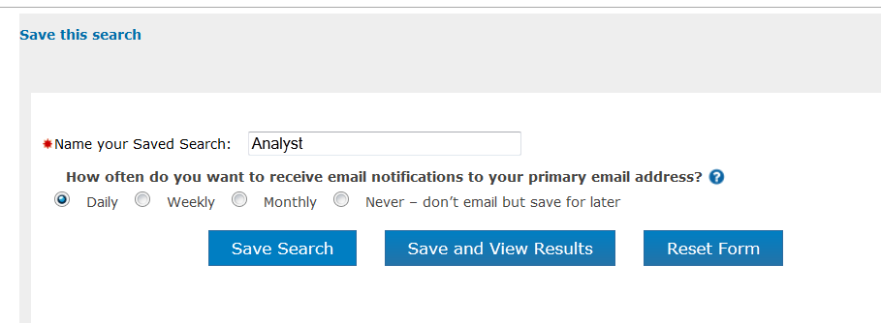
Name Search & Receive it Daily!
Notes:
Due to the sometimes brief application windows for postings, it is really important to receive these notifications on a DAILY basis. You can always delete or modify this as you wish.

Slide 39
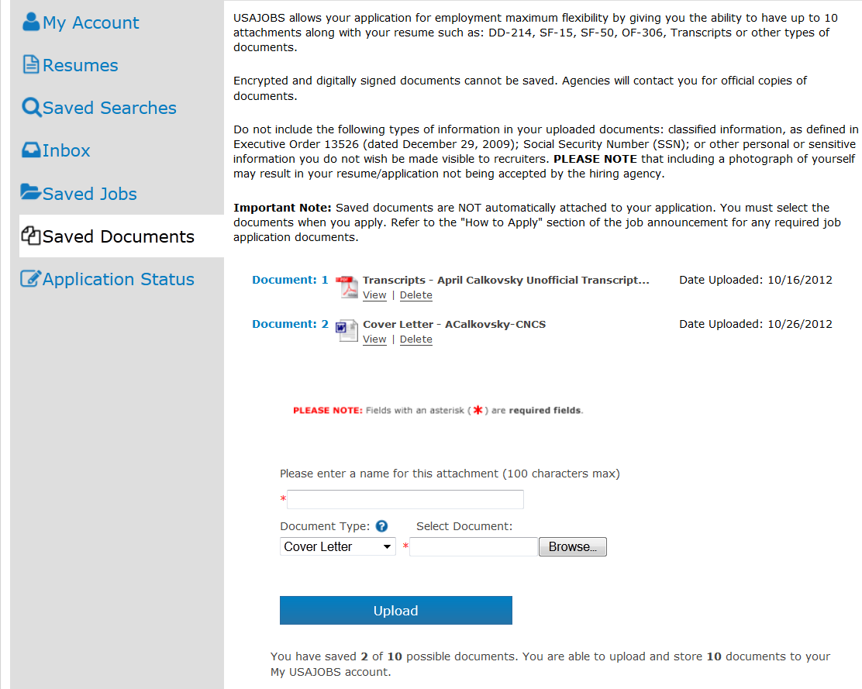
Saving Documents to USAJobs.gov
Notes:
The Saved Documents section of usajobs.gov allows you to store up to 10 documents. These documents could be cover letters, transcripts, advising reports, writing samples, or other required forms or documentation. Just be certain to name cover letters something unique that indicates the job it is for – there is almost no worse mistake than choosing the wrong cover letter for the wrong agency.
Even if the posting does not require a cover letter, ALWAYS WRITE ONE for federal positions.
For advice on cover letters, see the tip sheet Writing Cover Letters on the Arts and Sciences Career Services website:
http://www.asccareerservices.osu.edu/guides/resumes

Slide 40
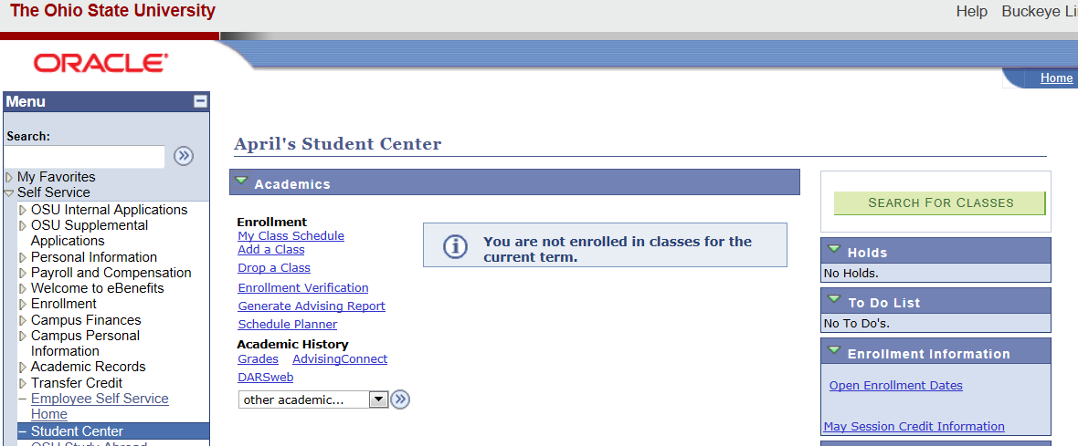
“Unofficial Transcript” = Advising Report
Log into “My Student Center” on BuckeyeLink: Generate Advising Report
Notes:
You can almost always use your Advising Report as an Unofficial Transcript – here’s where to find it.
Or, you can order an unofficial transcript from the University Registrar. Follow this link:
http://registrar.osu.edu/alumni/index_transcript.asp

Slide 41
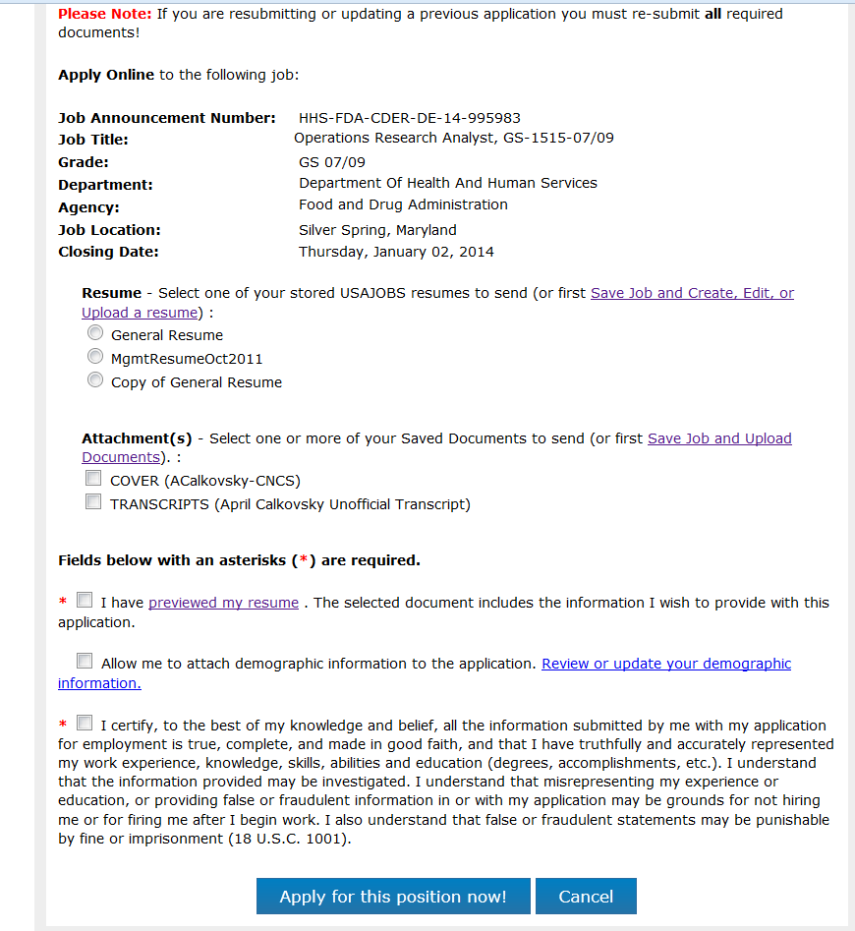
Submitting an Application
Notes:
Once you click “Apply Online” on a vacancy announcement, you will be asked which resume you are using, which attachments, and a couple of verification buttons. Then click Apply for this position now!

Slide 42
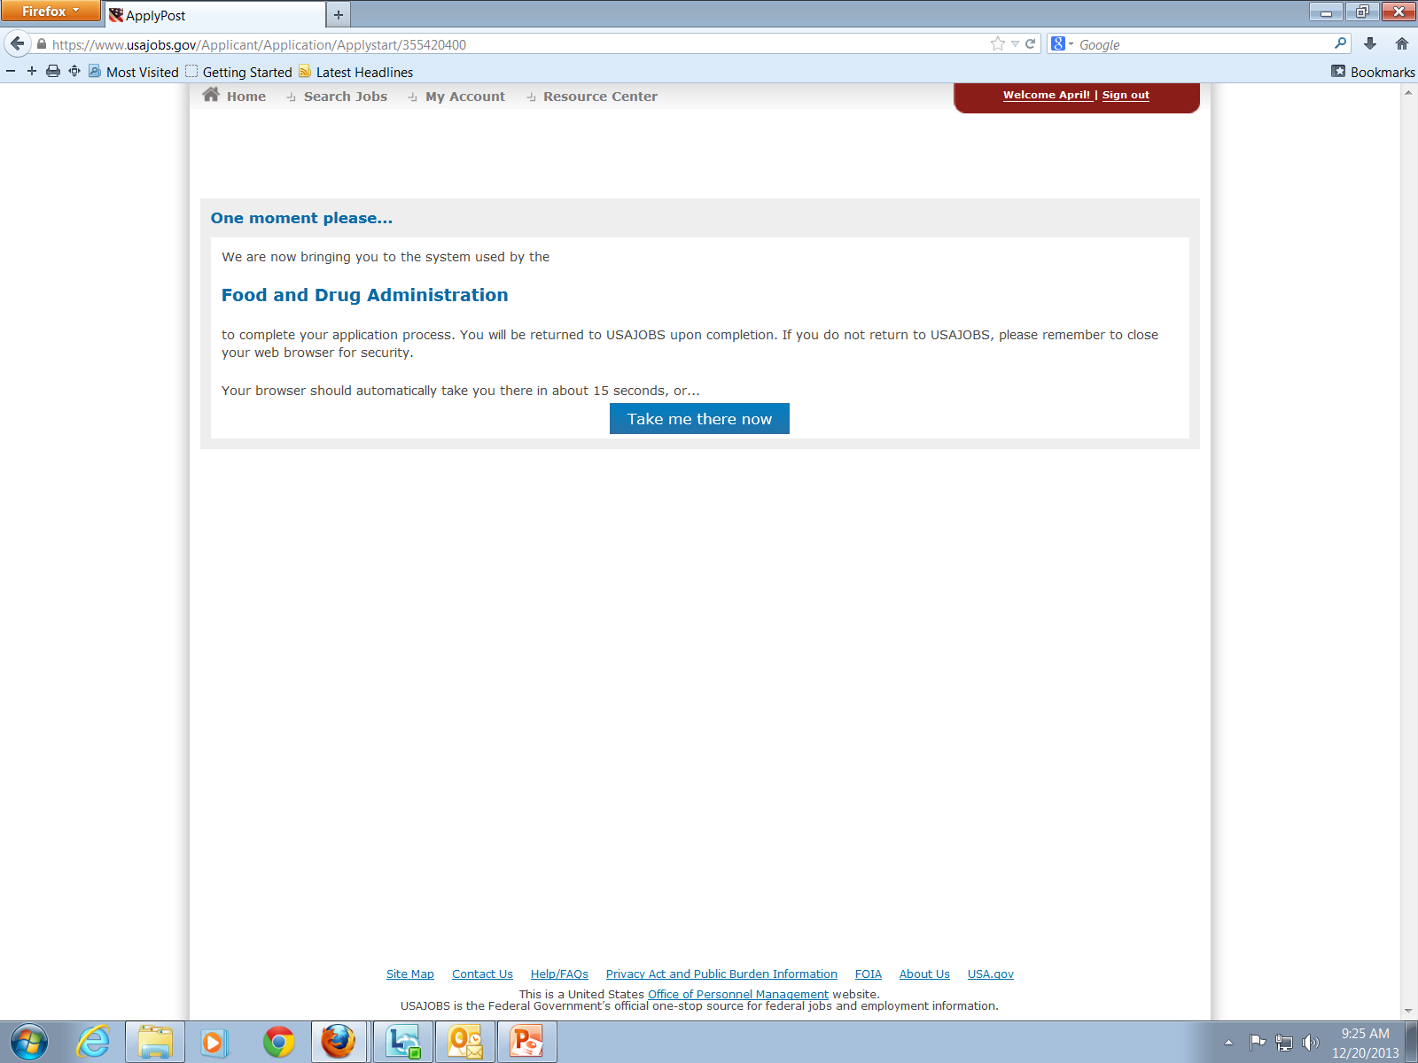
Submitting an Application
Taking you to another site to complete the application…

Slide 43
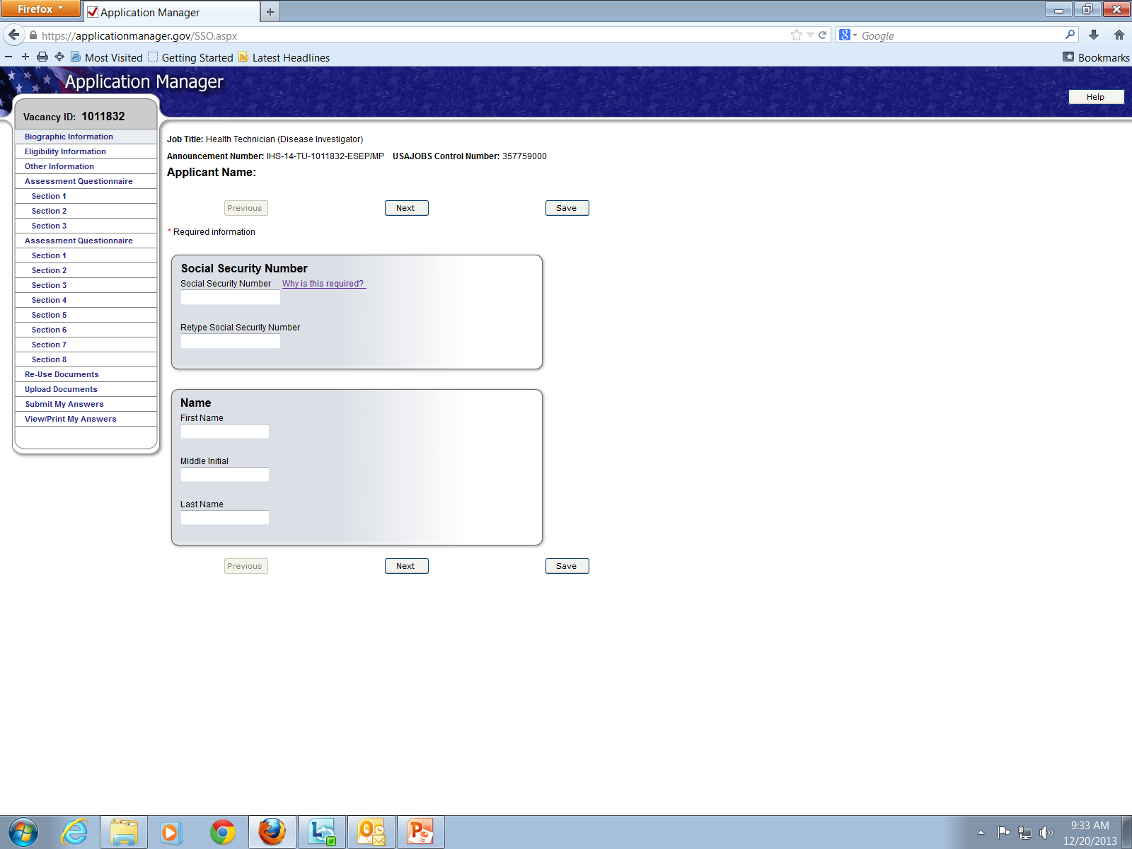
Submitting an Application
Notes:
Once there, follow the steps to complete the questionnaire and any other steps indicated in the process.

Slide 44
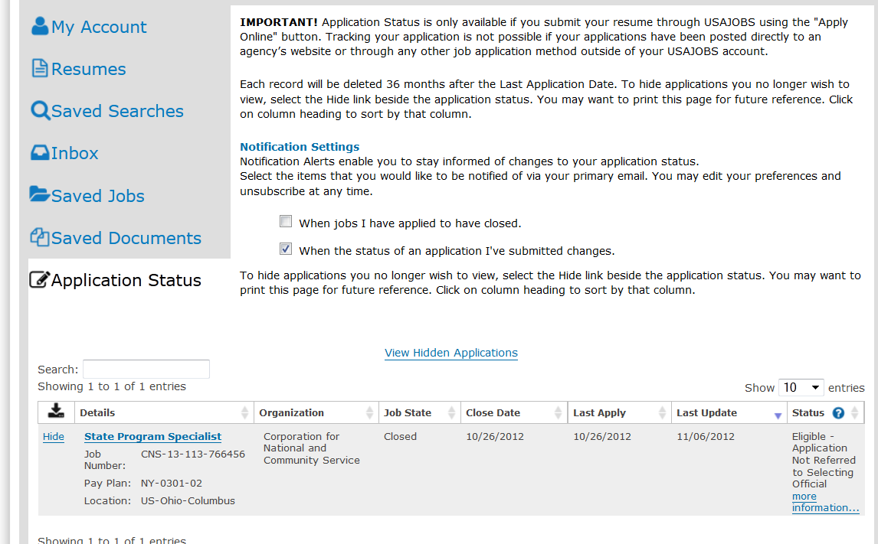
Checking on Applications
Notes:
After submitting an application, you can check the Application Status section of your account homepage.

Slide 45
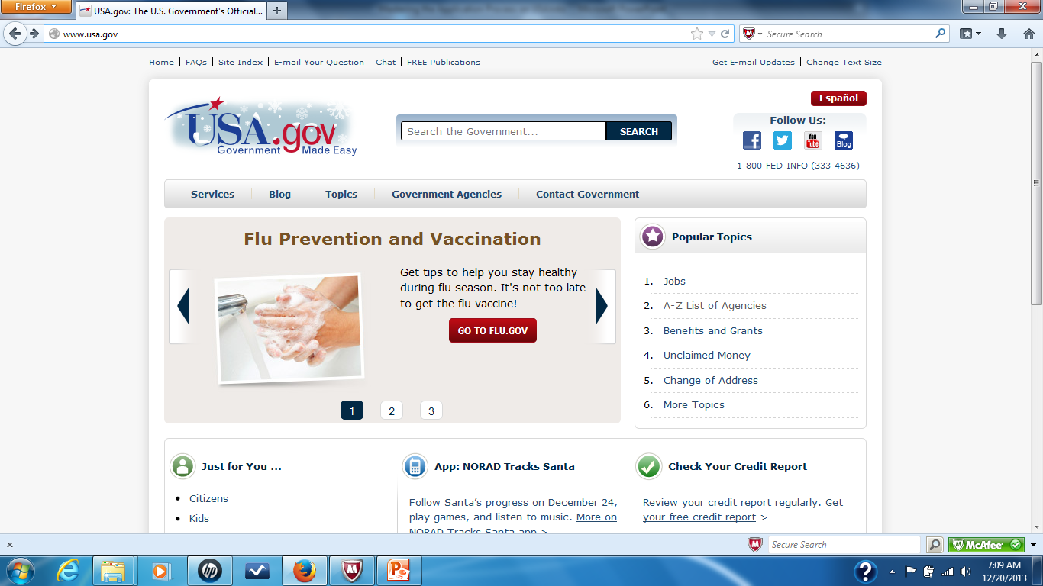
Checking on Applications: Agency Info
Notes:
If the job posting did not provide a phone number or contact person, then you can find the agencies HR department by going to usa.gov, clicking on the A-Z agency listing, clicking on the agency, and then going to Contact Us and calling their general number to ask for the HR department. Always have the Control Number or the Job Vacancy Posting Number available because that will make it easier for the HR professional to look up the information you need. Simply ask to check on the status of your application and where they might be in the hiring process.

